Slide 1


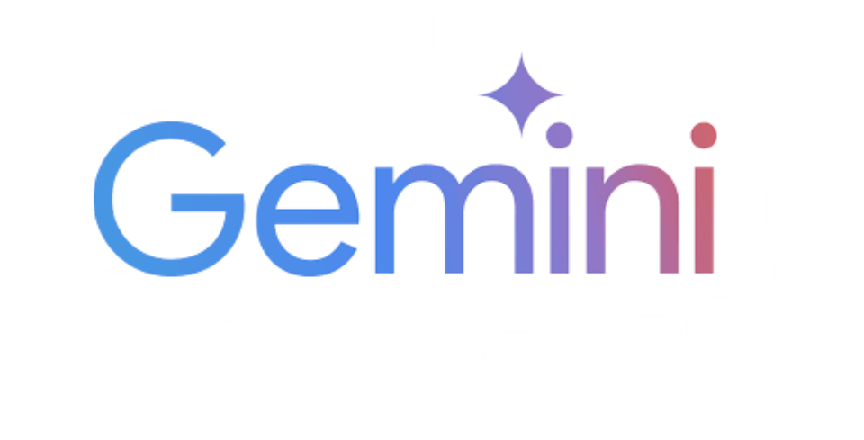
SYSTEM ARCHITECTURE
Local / Remote Sync
GITHUB REPOSITORY
including html, css, js files
USER
(Deploy / Hosting)
(1) Browser Access
CLOUDFLARE PAGES
USER BROWSER (HTML + CSS + JS)
About Personal-Profile
(2) fetch
HTTPS POST / message
Chatbot.js
CLOUDFLARE WORKER API (Backend / API Gateway)
CORS Handling, Prompt Generation,
Security Layer, JSON Response Wrapping (5),
API Key Secret Storage
(6) HTTP(S) Response
(Wrapped JSON)
(6) Rendering
(3) Generate
Prompt + Context
(4) Gemini API
Response
GEMINI API (LLM Model - Google AI Studio)
LLM Inference (text generation)
USER VIEW CHAT UI

